Slide 1




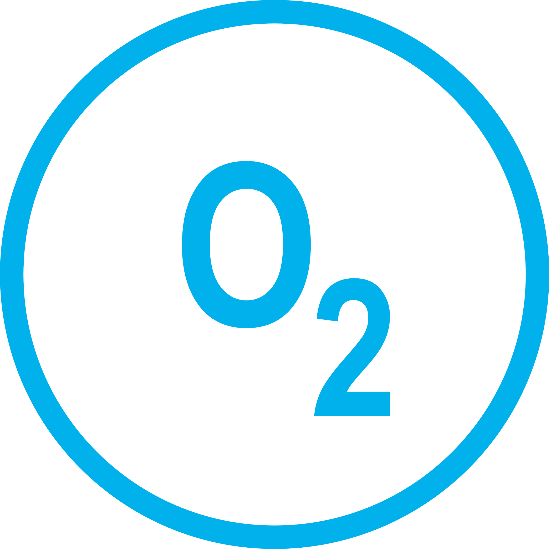
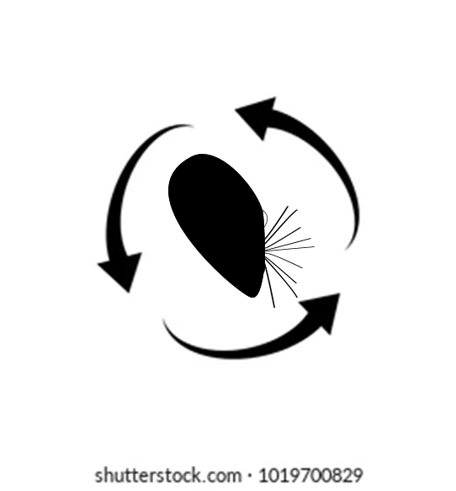
small-sized
respond to crab cue
large-sized
do not respond to crab cue
small-sized
respond to crab cue
large-sized
tdo not respond
to crab cue
high predation risk
high oxygen demand
higher metabolic rate
high predation risk
low oxygen demand
lower metabolic rate

Slide 2



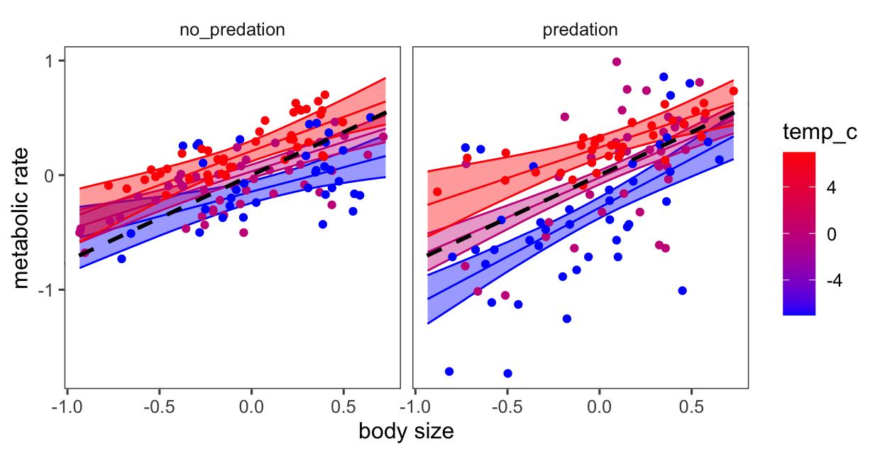



small-sized mussels
respond to crab cue
crab cues across temperature levels
small-sized mussels
high predation risk
high oxygen demand
higher metabolic rate
27°C
a) no crab cues
b) crab cues
small-sized mussels
high predation risk
low oxygen demand
lower metabolic rate
log metabolic rate
20°C
13°C
20°C
27°C
small-sized mussels
high predation risk
low oxygen demand
lower metabolic rate
log body size
log body size
13°C
large-sized mussels do not respond to crab cue

Slide 3

large-sized do not respond to crab cue
large-sized do not respond to crab cue
large-sized do not respond to crab cue
high predation risk
high oxygen demand
higher metabolic rate

